Slide 1
Signal Recovery Under Perturbations
Eeshan Malhotra, 14305R001
Under the guidance of
Prof. Ajit Rajwade
Department of Computer Science and Engineering, IIT Bombay
Dr. Karthik Gurumoorthy
Amazon Development Centre & ICTS Bangalore

Slide 2
Outline
Introduction
Perturbation in sensing matrix
Problem definition, algorithm and experimental results
Tomographic reconstruction with unknown angles
Problem definition, algorithm and experimental results
Interference among two sparse signals
Framework for improving recovery guarantees
Conclusions and Future Work

Slide 3

Introduction: Compressed Sensing Framework
$y= Φx$
or, $y= ΦΨθ$
Measurement
Mx1
Sensing matrix
MxN
Basis
NxN
Sparse Signal Representation
Nx1
M < N
Typical scenario: $y$, $Φ$, $Ψ$ are known. Recover $θ$ (or $x$).
$$\min_{x}{||y −Φx {||}_{2}^{2}\text{+ }λ}|\left|x\right||_{1}$$
In practice: Any of $y$, $Φ$, $Ψ$ may have inaccuracies, or perturbations, or even simply structural properties known
Notes:
Alternative being the constrained formulation of the problem

Slide 4
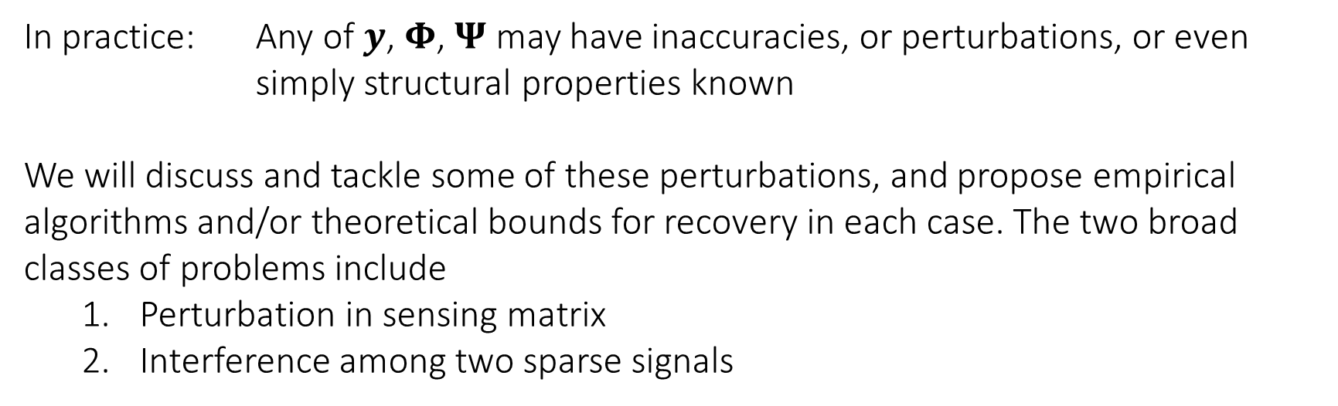

Introduction: Compressed Sensing Framework
$y= Φx$
$$\min_{x}{||y −Φx{||}_{2}^{2}\text{+ }λ}|\left|x\right||_{1}$$
In practice: Any of $y$, $Φ$, $Ψ$ may have inaccuracies, or perturbations, or even simply structural properties known
We will discuss and tackle some of these perturbations, and propose empirical algorithms and/or theoretical bounds for recovery in each case. The two broad classes of problems include
Perturbation in sensing matrix
Interference among two sparse signals

Slide 5
Perturbed Sensing Matrix
Section 1

Slide 6
Perturbed Sensing Matrix
Sensing matrix 𝚽 may have inaccuracies
Sources: Calibration error, relative motion between instrument and sample
E.g.: Frequencies of Fourier sensing matrix in MRI being off by a small amount, tomography projection angles being imperfectly known, etc.
Because of its widespread use, we consider the Fourier sensing matrix for measurement
The framework developed is more general in applicability than the specific cases mentioned

Slide 7
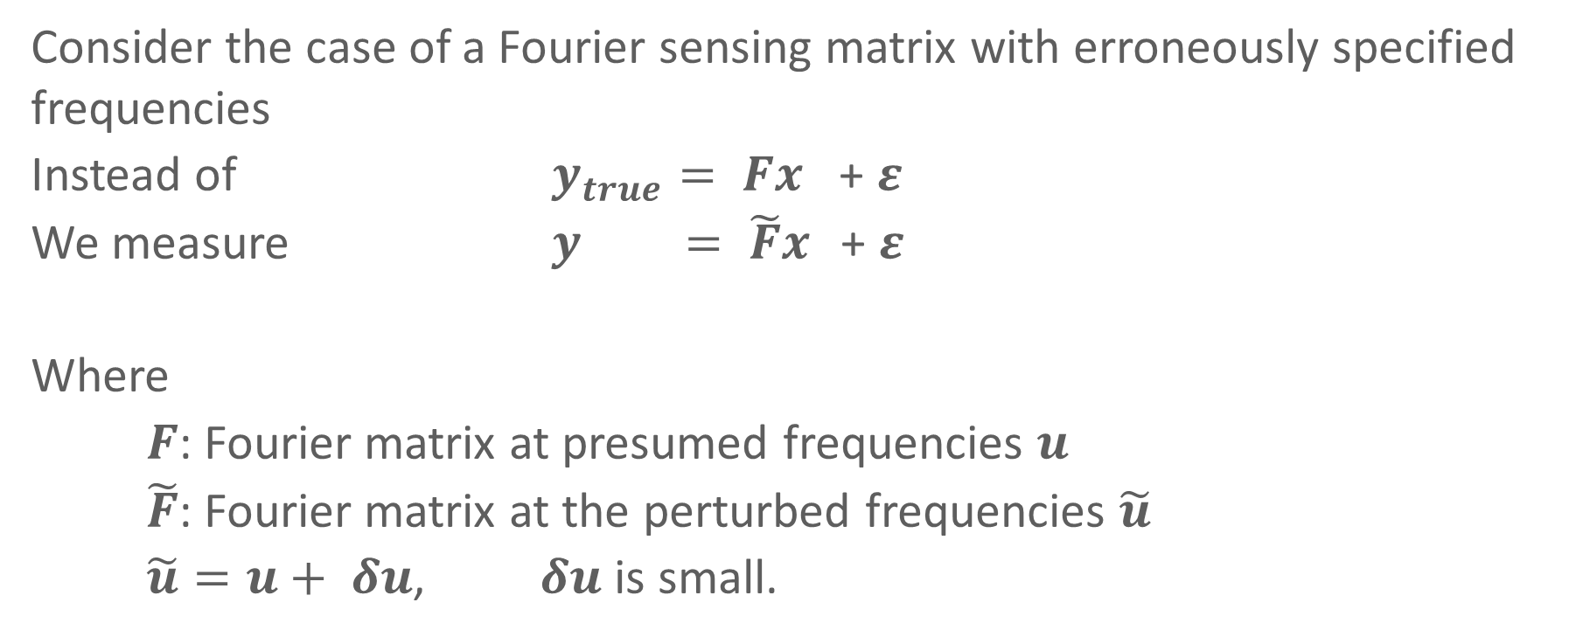
Perturbed Sensing Matrix
Consider the case of a Fourier sensing matrix with erroneously specified frequencies
Instead of $y_{true}= Fx$ + $ε$
We measure $y = \tilde{F}x$ + $ε$
Where
$F$: Fourier matrix at presumed frequencies $u$
$\tilde{F}$: Fourier matrix at the perturbed frequencies $\tilde{u}$
$\tilde{u}=u+ δu$, $δu$ is small.

Slide 8
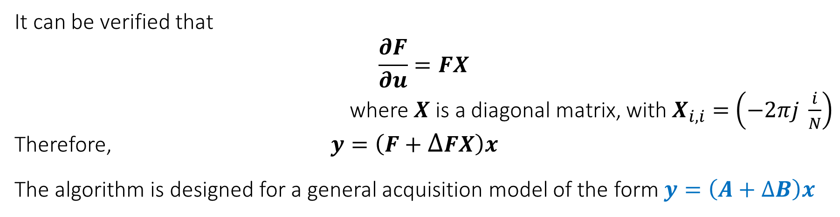
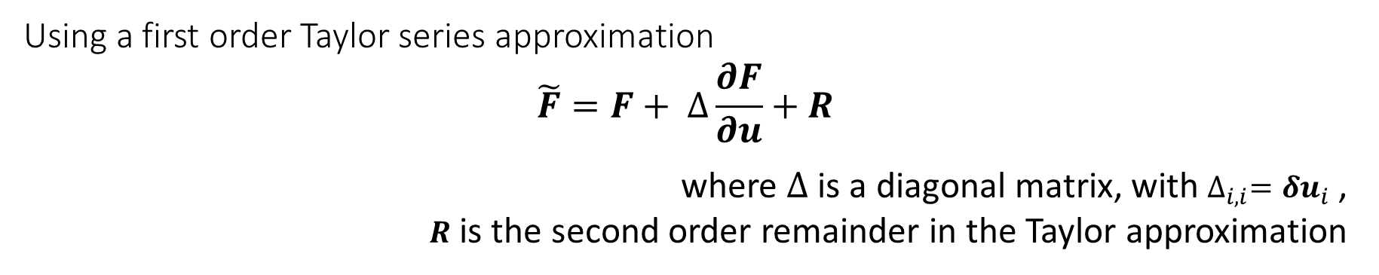
Perturbed Sensing Matrix: Framework
Using a first order Taylor series approximation
$$\tilde{F}=F+ ∆\frac{∂F}{∂u}+R$$
where $∆$ is a diagonal matrix, with $∆_{i,i}={δu}_{i}$ ,
$R$ is the second order remainder in the Taylor approximation
It can be verified that
$$\frac{∂F}{∂u}=FX$$
where $X$ is a diagonal matrix, with $X_{i,i}=$ $\left(−2πj \frac{i}{N}\right)$
Therefore, $y=\left(F+∆FX\right)x$
The algorithm is designed for a general acquisition model of the form $y=\left(A+∆B\right)x$

Slide 9
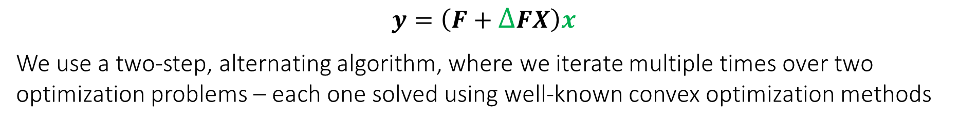
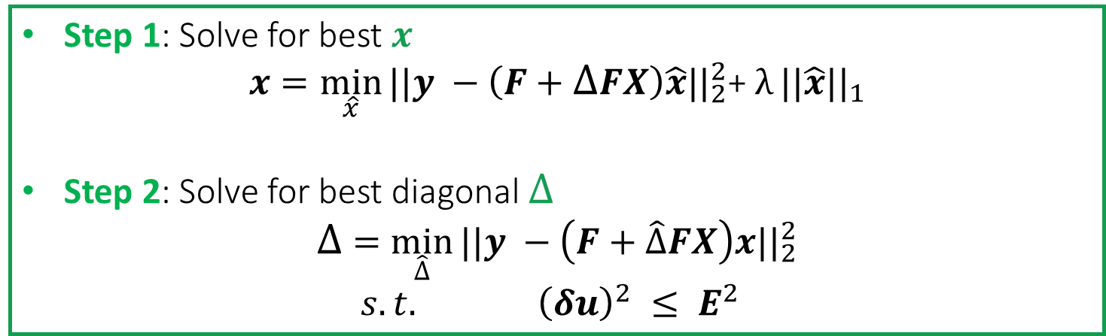
Perturbed Sensing Matrix: Algorithm
$$y=\left(F+∆FX\right)x$$
We use a two-step, alternating algorithm, where we iterate multiple times over two optimization problems – each one solved using well-known convex optimization methods
Step 1: Solve for best $x$
$$x=\min_{\hat{x}}{||y −\left(F+∆FX\right)\hat{x}{||}_{2}^{2}\text{+ }λ}||\hat{x}||_{1}$$
Step 2: Solve for best diagonal $∆$
$$∆ =\min_{\hat{∆}}{||y −\left(F+\hat{∆}FX\right)x{||}_{2}^{2}}$$
$s.t. {\left(δu\right)}^{2} ≤ E^{2}$
Where $E^{2}$ is an upper bound on the magnitude of the perturbations (a constant vector, containing the same value $E_{max}$ in each element)
Notes:
Initialize \delta to 0
Iterate till convergence

Slide 10

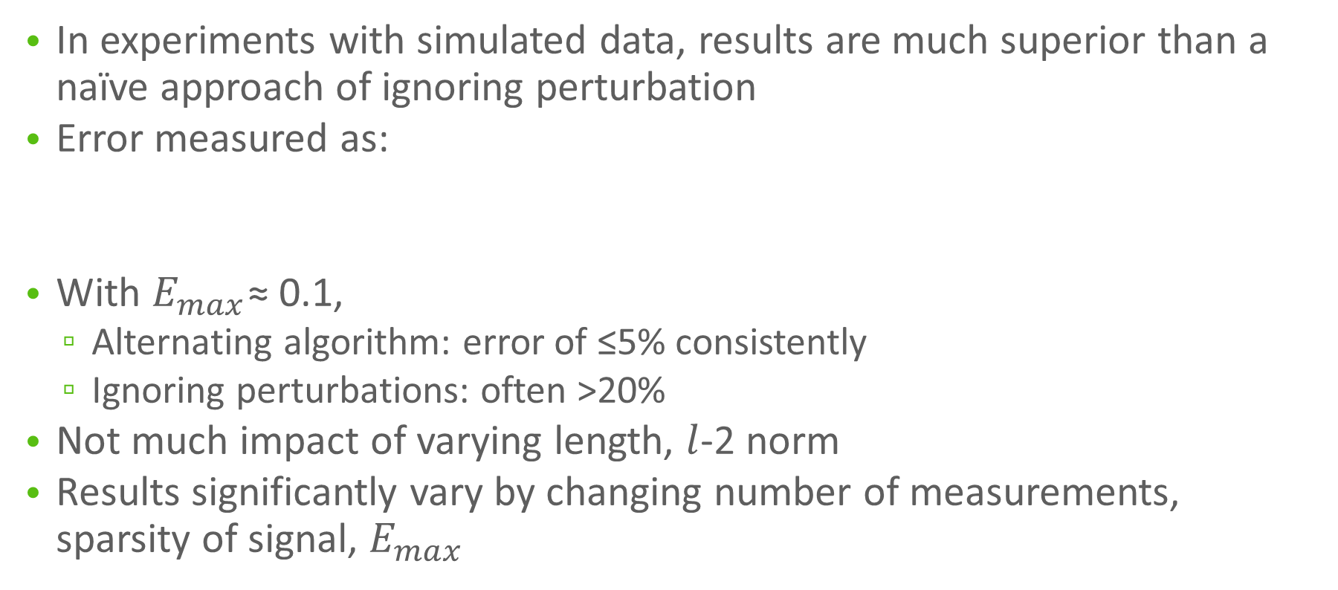
Perturbed Sensing Matrix: Results
In experiments with simulated data, results are much superior than a naïve approach of ignoring perturbation
Error measured as:
With $E_{max}$≈ 0.1,
Alternating algorithm: error of ≤5% consistently
Ignoring perturbations: often >20%
Not much impact of varying length, $l$-2 norm
Results significantly vary by changing number of measurements, sparsity of signal, $E_{max}$

Slide 11
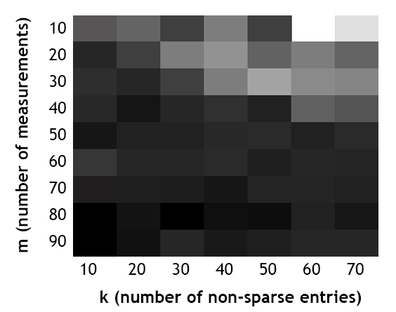
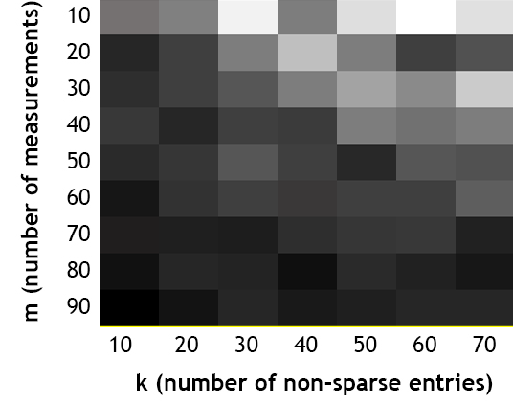
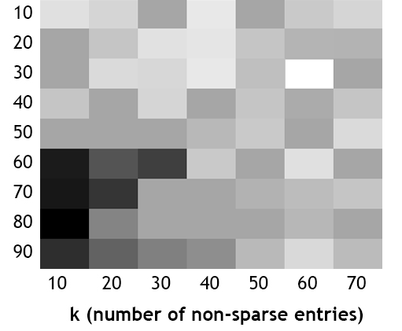



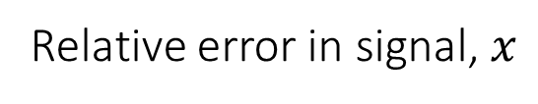
Perturbed Sensing Matrix: Results
Relative error in signal, $x$
Darker cells denote lower fractional error.
Min error: 2.5%; Max error: 95%
$$E_{max}=0.01$$
$$E_{max}=0.1$$
$$E_{max}=0.5$$

Slide 12

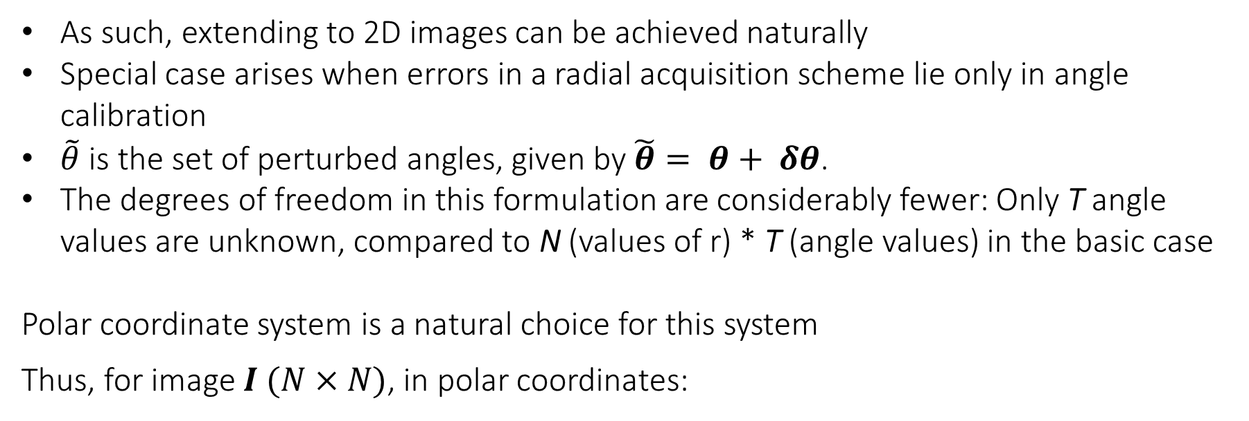
Perturbed Sensing Matrix: 2D recovery
As such, extending to 2D images can be achieved naturally
Special case arises when errors in a radial acquisition scheme lie only in angle calibration
$\tilde{θ}$ is the set of perturbed angles, given by $\tilde{θ}= θ+ δθ$.
The degrees of freedom in this formulation are considerably fewer: Only T angle values are unknown, compared to N (values of r) * T (angle values) in the basic case
Polar coordinate system is a natural choice for this system
Thus, for image $I (N×N)$, in polar coordinates:
Notes:
Talk about the error in frequencies becoming large even if error in \theta is small

Slide 13
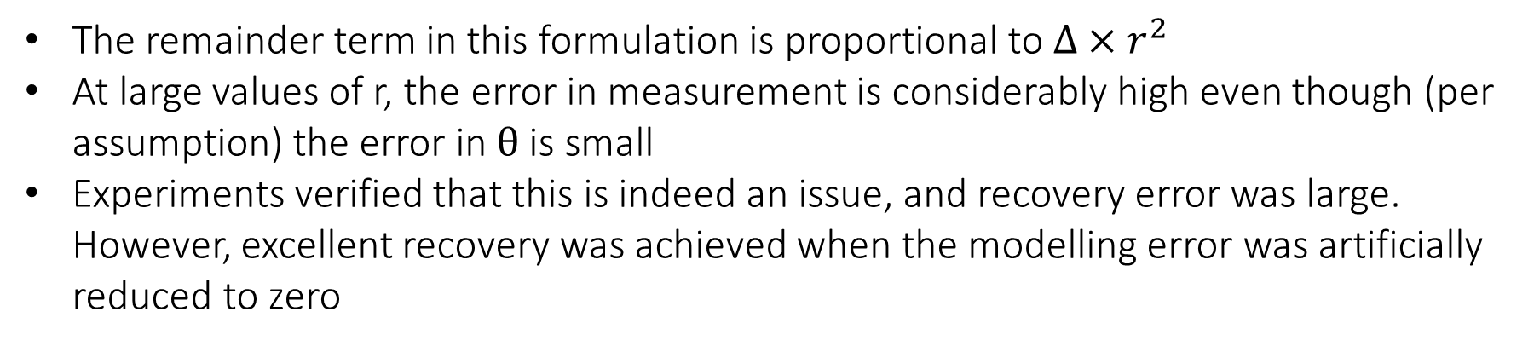
Perturbed Sensing Matrix: 2D recovery
Again, using a Taylor’s series approximation,
Which is also gives an acquisition model of the form $y ≈(A+ ∆B)x$
The remainder term in this formulation is proportional to $∆×r^{2}$
At large values of r, the error in measurement is considerably high even though (per assumption) the error in $θ$ is small
Experiments verified that this is indeed an issue, and recovery error was large. However, excellent recovery was achieved when the modelling error was artificially reduced to zero
Notes:
Talk about the error in frequencies becoming large even if error in \theta is small

Slide 14
Perturbed Sensing Matrix: Future Work
Proposed Solutions (Yet to be investigated)
Only use measurements in the low r range in the alternating algorithm. Once the angle estimates converge, utilize all available measurements to re-estimate the signal
Pooling method: Use multiple signals measured with the same angle perturbations. This increases the number of available data points (measurements), while increasing the number of unknowns by a smaller amount (sparse signals to be recovered)

Slide 15
Tomographic Recovery with Unknown View Angles
Section 2

Slide 16
Unknown View Angles: Motivation
In computed tomography, an extreme case of sensing matrix being erroneously known is when view-angles for projections are completely unknown
Eg: Cryo-electron microscopy, and to a lesser degree, patient motion in medical CT
However it has been shown by Basu & Bresler (2000), that under modest assumptions, the image is still uniquely determined by the set of projections (up to a global rotation and reflection ambiguity)
Existing work (Coifman et al (2008), Fang et al (2010), Fang et al (2011)) typically -
Produces an ordering for projections (often using dimensionality reduction), and assumes a distribution to determine values of angles
Requires an extremely large number of angles for the recovery to be stable
Notes:
Describe tomography basics? Fourier slice theorem

Slide 17
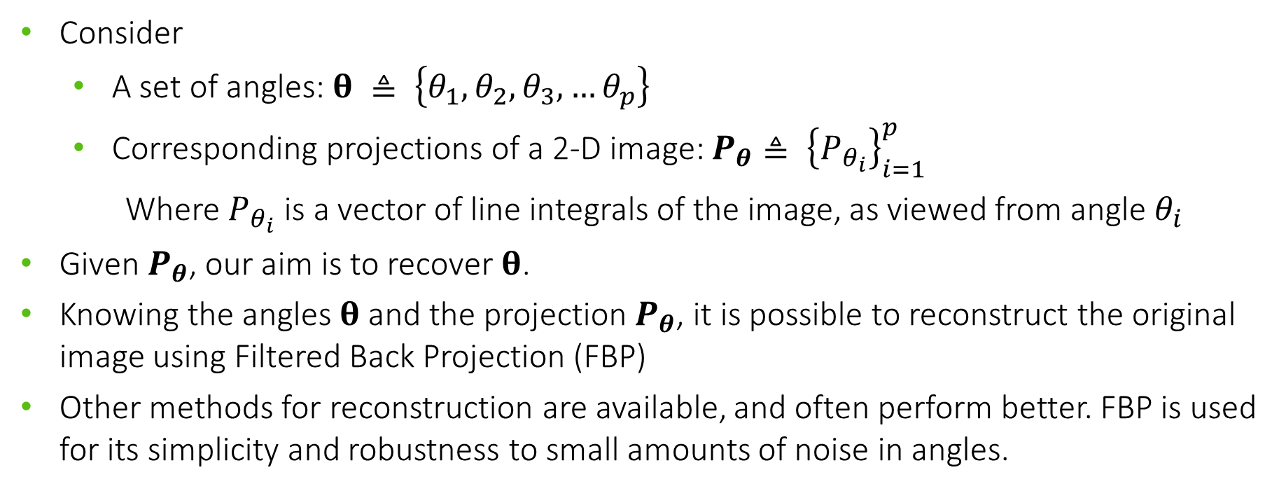
Unknown View Angles: Problem Statement
Consider
A set of angles: $θ ≜ \left\{θ_{1},θ_{2},θ_{3},…θ_{p}\right\}$
Corresponding projections of a 2-D image: $P_{θ}≜ {\left\{P_{θ_{i}}\right\}}_{i=1}^{p}$
Where $P_{θ_{i}}$ is a vector of line integrals of the image, as viewed from angle $θ_{i}$
Given $P_{θ}$, our aim is to recover $θ$.
Knowing the angles $θ$ and the projection$P_{θ}$, it is possible to reconstruct the original image using Filtered Back Projection (FBP)
Other methods for reconstruction are available, and often perform better. FBP is used for its simplicity and robustness to small amounts of noise in angles.

Slide 18
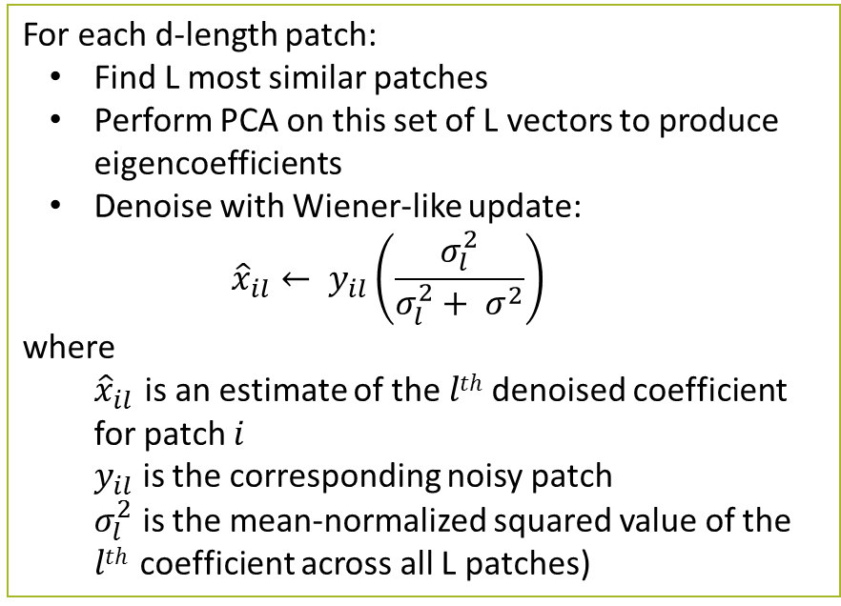
Unknown View Angles: Algorithm (Denoising)
The first step in the algorithm involves denoising the projections, since noisy projections may significantly hamper the efficacy of the following step
Patch-based PCA denoising method
For each d-length patch:
Find L most similar patches
Perform PCA on this set of L vectors to produce eigencoefficients
Denoise with Wiener-like update:
$${\hat{x}}_{il}← y_{il}\left(\frac{σ_{l}^{2}}{σ_{l}^{2}+ σ^{2}}\right)$$
where
${\hat{x}}_{il}$ is an estimate of the $lth$ denoised coefficient for patch $i$
$y_{il}$ is the corresponding noisy patch
$σ_{l}^{2}$ is the mean-normalized squared value of the $lth$coefficient across all L patches)
Similar patches can be found in the same projection as well

Slide 19
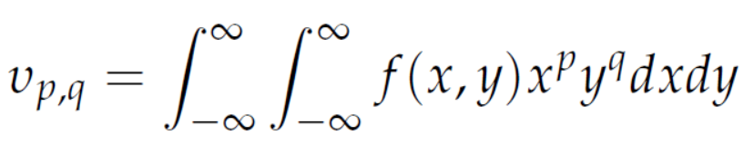
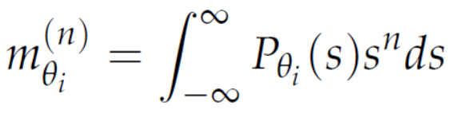
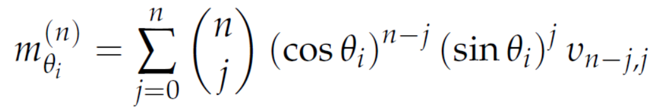
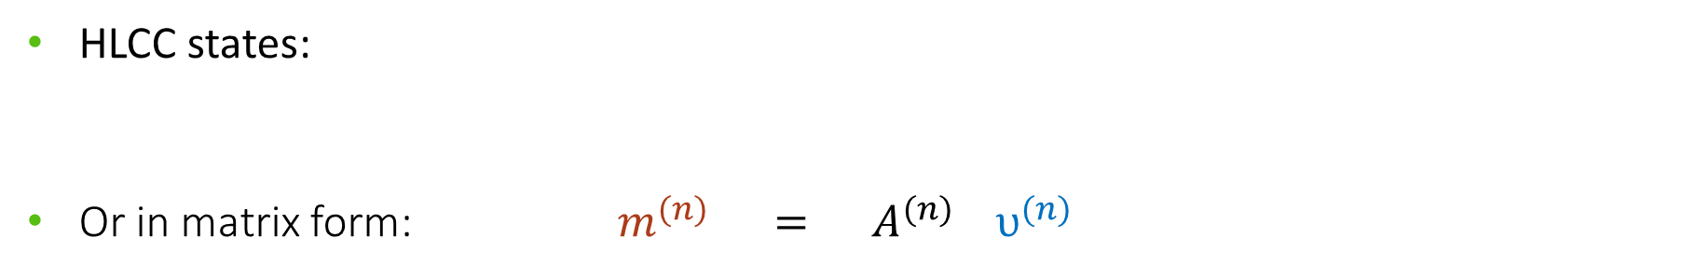
Unknown View Angles: Algorithm (Coordinate Descent)
This algorithm utilizes the Helgasson-Ludwig Consistency Conditions (HLCC)
HLCC describes a relationship between the n^{th} order projection moments and the n^{th} order image moments
Given p projections, the p n^{th}-order projection moments are
Given the underlying image, the (n+1) n^{th}-order image moments are
HLCC states:
Or in matrix form: $m^{(n)} = A^{(n)}{ υ}^{(n)}$

Slide 20
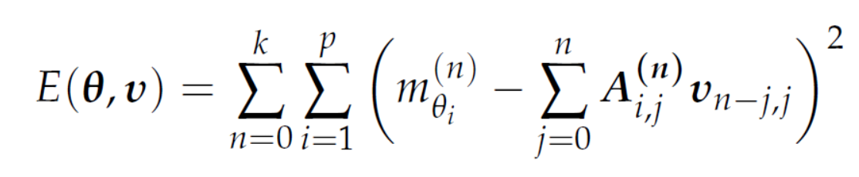
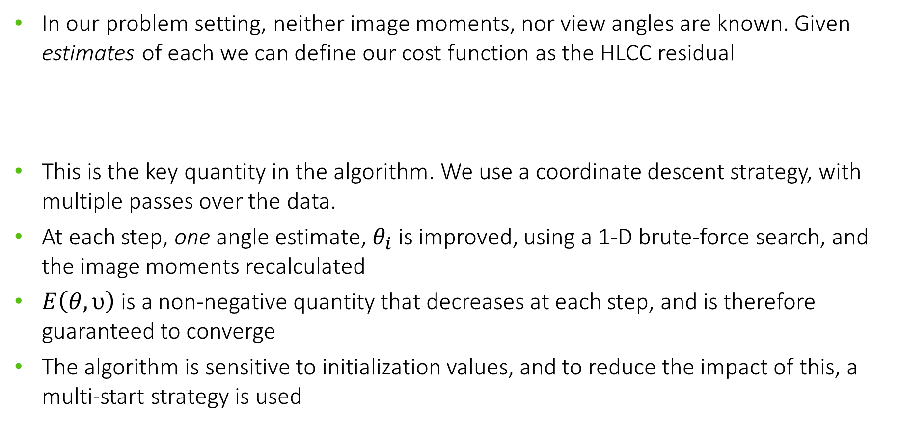
Unknown View Angles: Algorithm (Coordinate Descent)
In our problem setting, neither image moments, nor view angles are known. Given estimates of each we can define our cost function as the HLCC residual
This is the key quantity in the algorithm. We use a coordinate descent strategy, with multiple passes over the data.
At each step, one angle estimate, $θ_{i}$ is improved, using a 1-D brute-force search, and the image moments recalculated
$E\left(θ, υ\right)$ is a non-negative quantity that decreases at each step, and is therefore guaranteed to converge
The algorithm is sensitive to initialization values, and to reduce the impact of this, a multi-start strategy is used

Slide 21
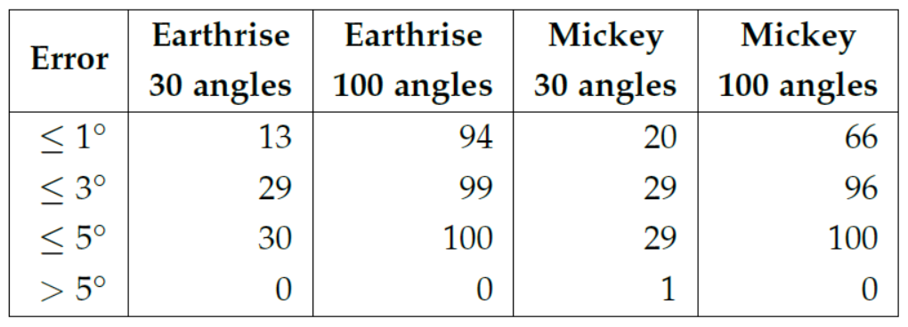
Unknown View Angles: Results
Simulated experiments gave quite good recovery, across multiple images, even with very few angles
Most estimates were off by ≤ 3º, with rare exceptions going above 5º
(Rotational ambiguity was eliminated manually for clearer representation)

Slide 22
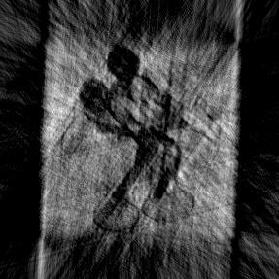
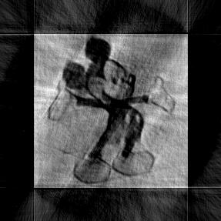
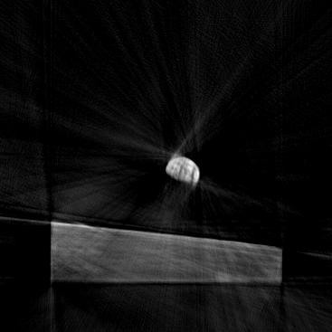
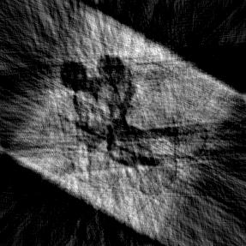
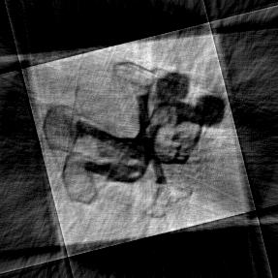
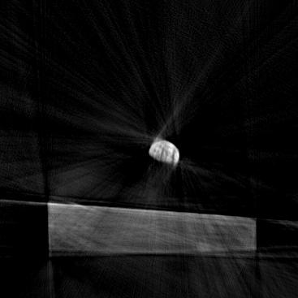
Unknown View Angles: Results
Reconstruction results using FBP
5% noise
Actual angles
Estimated Angles
30 angles
100 angles
100 angles

Slide 23
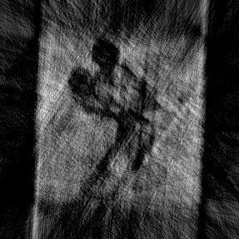
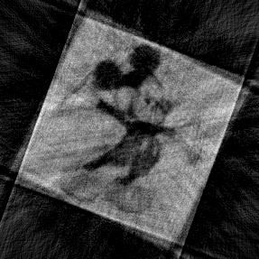

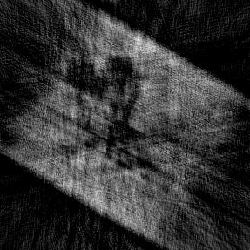
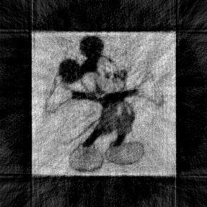
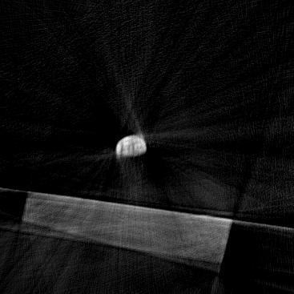
Unknown View Angles: Results
Reconstruction results using FBP
10% noise
Actual angles
Estimated Angles
30 angles
100 angles
100 angles

Slide 24
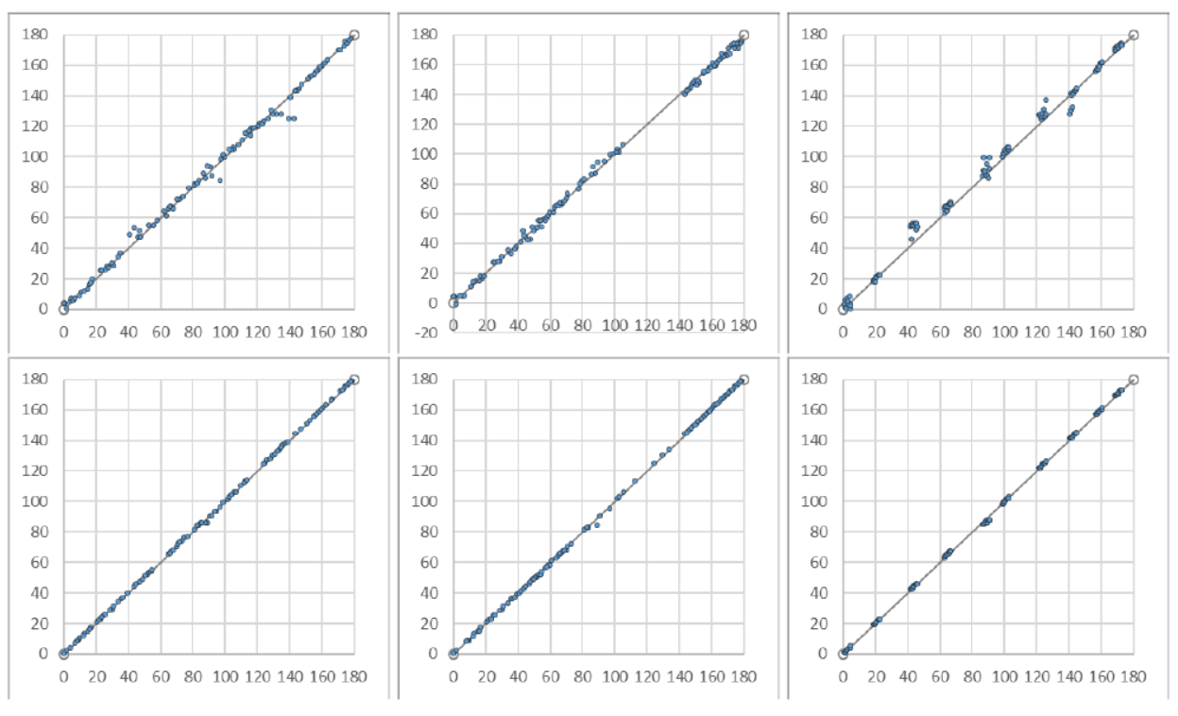
Unknown View Angles: Results
The algorithm also proved to be extremely robust to the distribution from which the angles were taken. Angle recovery under 10% noise:
Uniform
Non-uniform
Peaky
X: True angle value
Y: Estimated angle value
‘mickey’
‘earthrise’
(Rotational ambiguity was eliminated manually for clearer representation)

Slide 25
Unknown View Angles: Conclusions and Future Work
This algorithm extends the angle recovery to scenarios where the projection angles are completely unknown
The recovery is excellent, considering there is zero available knowledge about view angles, and the algorithm is robust. However, the angle errors are not small enough for applications requiring precise measurements
For such scenarios, we propose a pipeline using the Coordinate descent algorithm for obtaining approximate estimates of the angles, followed by fine-tuning using the alternating algorithm described in the first section

Slide 26
Interference Among Sparse Signals
Section 3

Slide 27
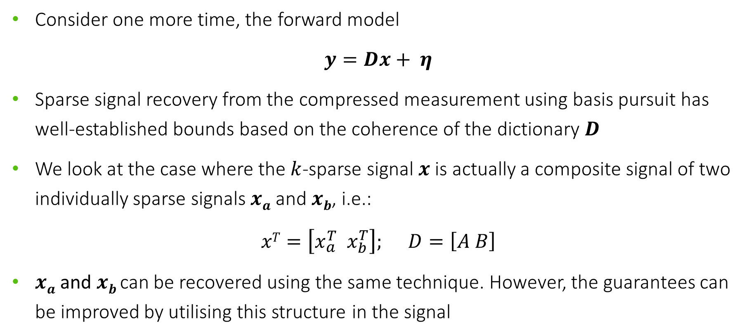
Interference: Background
Consider one more time, the forward model
$$y=Dx+ η$$
Sparse signal recovery from the compressed measurement using basis pursuit has well-established bounds based on the coherence of the dictionary $D$
We look at the case where the $k$-sparse signal $x$is actually a composite signal of two individually sparse signals $xa$ and $xb$, i.e.:
$$xT=\left[x_{a}^{T} x_{b}^{T}\right]; D=\left[A B\right]$$
$xa$ and $xb$can be recovered using the same technique. However, the guarantees can be improved by utilising this structure in the signal

Slide 28
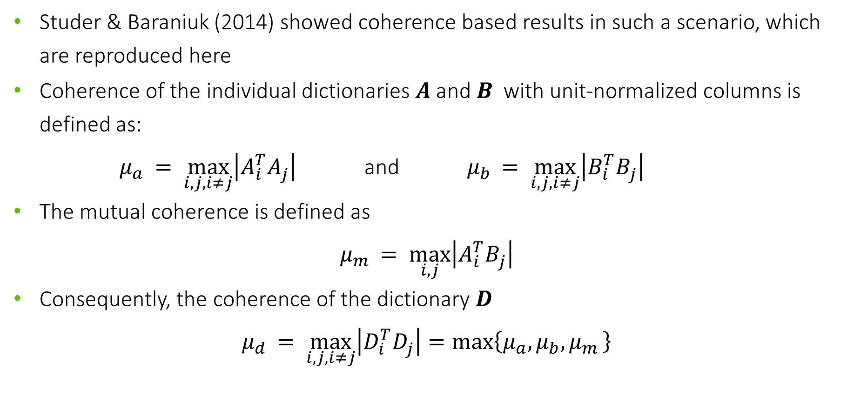
Interference: Background
Studer & Baraniuk (2014) showed coherence based results in such a scenario, which are reproduced here
Coherence of the individual dictionaries $A$ and $B$ with unit-normalized columns is defined as:
$μ_{a }= \max_{i,j,i≠j}\left|A_{i}^{T}A_{j}^{ }\right|$ and $μ_{b }= \max_{i,j,i≠j}\left|B_{i}^{T}B_{j}^{ }\right|$
The mutual coherence is defined as
$$μ_{m }= \max_{i,j}\left|A_{i}^{T}B_{j}^{ }\right|$$
Consequently, the coherence of the dictionary $D$
$$μ_{d }= \max_{i,j,i≠j}\left|D_{i}^{T}D_{j}^{ }\right|=max\left\{μ_{a},μ_{b},μ_{m }\right\}$$

Slide 29
Studer & Baraniuk (2014) showed coherence based results in such a scenario, which are reproduced here
Coherence of the individual dictionaries $A$ and $B$ with unit-normalized columns is defined as:
$μ_{a }= \max_{i,j,i≠j}\left|A_{i}^{T}A_{j}^{ }\right|$ and $μ_{b }= \max_{i,j,i≠j}\left|B_{i}^{T}B_{j}^{ }\right|$
The mutual coherence is defined as
$$μ_{m }= \max_{i,j}\left|A_{i}^{T}B_{j}^{ }\right|$$
Consequently, the coherence of the dictionary $D$
$$μ_{d }= \max_{i,j,i≠j}\left|D_{i}^{T}D_{j}^{ }\right|=max\left\{μ_{a},μ_{b},μ_{m }\right\}$$

Slide 30
Thank You

